Slide 1
CS4104
Applied Machine Learning
Lecture No 4
Inductive Learning-II
(Decision Trees)
Spring 2025
1

Slide 2

DECISION TREES
Concept Space Search
&
Learning Bias
of
Decision Trees
1
Notes:
ID3, C4.5, and CART are all algorithms used for decision tree construction in machine learning, but they differ in their approach, criteria, and handling of data. Here’s a breakdown of their key differences:
1. ID3 (Iterative Dichotomiser 3)
Developed by: Ross Quinlan in 1986.
Splitting Criterion: Uses Information Gain to select the attribute that provides the most information about the class label. It measures the reduction in entropy (uncertainty) after a dataset is split on an attribute.
Handling of Data:
Works only with categorical data. Continuous attributes must be discretized before use.
Does not handle missing values effectively.
Tree Structure: Produces a multi-way tree, meaning each node can have multiple branches (one for each category of the attribute).
Pruning: Does not incorporate pruning; thus, it can overfit the training data.
2. C4.5
Developed by: Ross Quinlan, as an extension of ID3 in 1993.
Splitting Criterion: Uses Gain Ratio, which adjusts the information gain by taking into account the intrinsic information of a split. This helps to prevent a bias towards attributes with many categories.
Handling of Data:
Can handle both categorical and continuous attributes natively.
Can manage missing values by assigning a probability distribution to the missing data.
Tree Structure: Also produces a multi-way tree but includes the ability to handle continuous attributes without prior discretization.
Pruning: Incorporates post-pruning techniques to reduce overfitting, improving generalization on unseen data.
3. CART (Classification and Regression Trees)
Developed by: Breiman et al. in 1986.
Splitting Criterion: Uses Gini Impurity for classification tasks and Mean Squared Error for regression tasks. Gini impurity measures the impurity of a dataset and aims to minimize it.
Handling of Data:
Can handle both categorical and continuous data.
Missing values can be handled by surrogate splits, which allow the algorithm to effectively utilize available data.
Tree Structure: Produces binary trees, meaning each node splits into exactly two branches, which simplifies the structure.
Pruning: Uses cost complexity pruning (also called weakest link pruning) to avoid overfitting, balancing tree depth and accuracy.
Summary Table
| Feature | ID3 | C4.5 | CART | |-----------------------|-----------------|------------------|---------------------| | Developed by | Ross Quinlan | Ross Quinlan | Breiman et al. | | Splitting Criterion | Information Gain | Gain Ratio | Gini Impurity (Classification) / Mean Squared Error (Regression) | | Data Handling | Categorical only | Categorical and Continuous | Categorical and Continuous | | Missing Values | Poor handling | Good handling | Good handling | | Tree Structure | Multi-way | Multi-way | Binary | | Pruning | None | Post-pruning | Cost complexity pruning |
Conclusion
In summary, while ID3 is a foundational algorithm focusing on information gain, C4.5 builds on this by improving handling of data types and incorporating pruning techniques. CART, on the other hand, provides a binary tree structure and offers flexibility for both classification and regression tasks, making it a versatile choice in many machine learning applications.

Slide 3
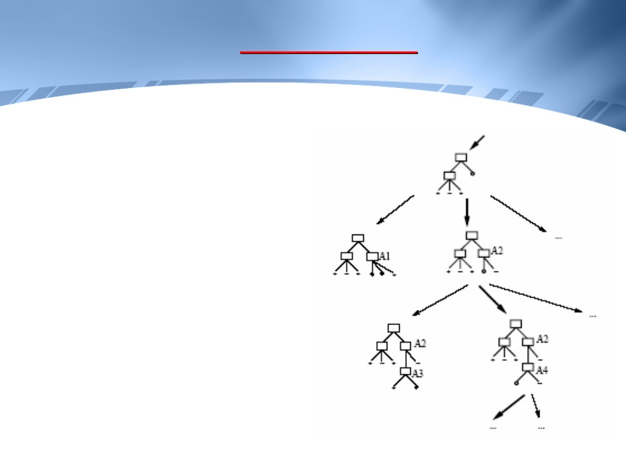
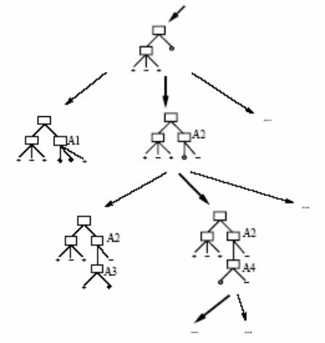
DECISION TREES
Hypothesis Space Search
ID3 can be characterized as
searching a space of
hypotheses for one that fits
the training examples
The space searched is the set
of possible decision trees
ID3 performs a simple-to-
complex, hill-climbing
search through this
hypothesis space
2

Slide 4
DECISION TREES
Hypothesis Space Search
It begins with an empty tree,
then considers more and
more elaborate hypothesis
in search of a decision tree
that correctly classifies the
training data
The evaluation function that
guides this hill-climbing
search is the information
gain measure
3

Slide 5
DECISION TREES
Hypothesis Space Search
Some points to note:
• The hypothesis space of all decision trees is a complete
space. Hence the target function is guaranteed to be
present in it.
4

Slide 6
DECISION TREES
Hypothesis Space Search
• ID3 maintains only a single current hypothesis as it
searches through the space of decision trees.
By determining only a single hypothesis, ID3 loses the
capabilities that follow from explicitly representing all
consistent hypotheses.
For example, it does not have the ability to determine
how many alternative decision trees are consistent with
the training data, or to pose new instance queries that
optimally resolve among these competing hypotheses
5

Slide 7
DECISION TREES
Hypothesis Space Search
• ID3 performs no backtracking, therefore it is
susceptible to converging to locally optimal solutions
• ID3 uses all training examples at each step to refine its
current hypothesis. This makes it less sensitive to
errors in individual training examples.
However, this requires that all the training examples
are present right from the beginning and the learning
cannot be done incrementally with time
6

Slide 8
DECISION TREES
Learning Bias during Induction
• Given a collection of training examples, there are
typically many decision trees consistent with these
examples
• Describing the inductive bias of ID3 means describing the
basis by which it chooses one of these consistent
hypotheses over the others
7

Slide 9
DECISION TREES
Learning Bias during Induction
• We cannot describe precisely the bias, but we can say
approximately that:
- Its selection prefers shorter trees over longer ones
- Trees with high info. gain attributes close to the root are
preferred
8

Slide 10
DECISION TREES
Learning Bias during Induction
• We can say “it absolutely prefers shorter trees over
longer ones” if there is an algorithm such that:
- It begins with an empty tree and searches breadth
first through progressively more complex trees,
first considering “ all ” trees of depth 1, then “ all ”
trees of depth 2, etc.
- Once it finds a decision tree consistent with the
training data, it returns the smallest consistent
tree
9

Slide 11
DECISION TREES
Learning Bias during Induction
• Is this bias for shorter trees a sound basis for
generalization beyond the training data?
• William of Occam, in the year 1320, thought of the
following bias (called Occam’s razor):
Prefer the simplest hypothesis that fits the data
• One argument in its favor is that because there are fewer
short hypotheses than long ones, it is less likely that a
short hypothesis coincidentally fit the training data
10

Slide 12
DECISION TREES
Learning Bias during Induction
• Example:
Let there be a small set of 20 training examples
We might expect to be able to find many 500 node
decision trees consistent with these examples, than 5 node
decision trees
We might therefore believe that a 5-node tree is less
likely to be a statistical coincidence and prefer this
hypothesis over the 500 node hypothesis
11

Slide 13
DECISION TREES
Decision Trees:
Issues in Learning
12

Slide 14
DECISION TREES
Decision Trees: Issues in Learning
Practical issues in learning decision trees include:
• How deeply to grow the decision tree
• Handling continuous attributes
• Choosing an appropriate attribute selection measure
• Handling training data with missing attribute values
• Handling attributes with differing costs
13

Slide 15
DECISION TREES
Avoiding Over-fitting the Data
A hypothesis over-fits the training examples if some other
hypothesis that fits the training examples less well actually
performs better over the testing set
Figure illustrates the impact of over-fitting in a typical
application of decision tree learning
14

Slide 16
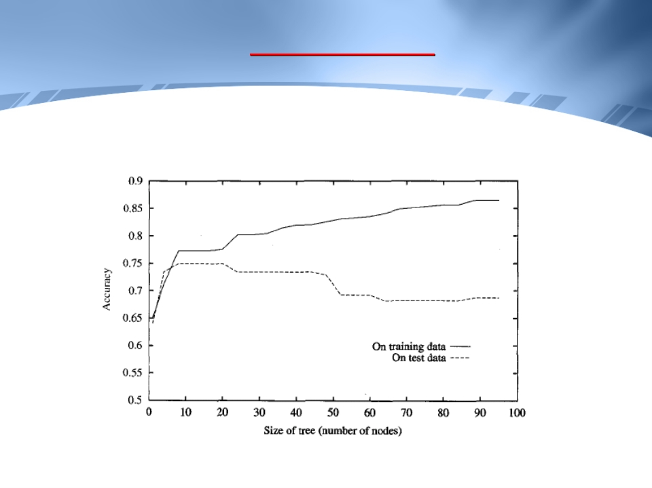
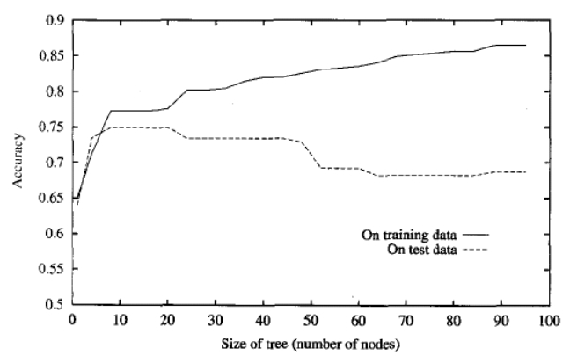
DECISION TREES
Avoiding Over-fitting the Data
15

Slide 17
DECISION TREES
Avoiding Over-fitting the Data
The ID3 algorithm grows each branch of the tree just deeply
enough to perfectly classify the training examples
While this is sometimes a reasonable strategy, in fact it can
lead to difficulties when there is noise in the data, or when
the number of training examples is too small to produce a
representative sample of the true target function
In either of these cases, ID3 can produce trees that over-fit
the training examples
16

Slide 18
DECISION TREES
Avoiding Over-fitting the Data
Over-fitting can occur when the training examples contain
random errors or noise
Example:
If we have the following incorrect training observation
Sunny, Hot, Normal Humidity, Strong Wind = No Tennis
The decision tree will become more complex to accommodate
this training observation
17

Slide 19
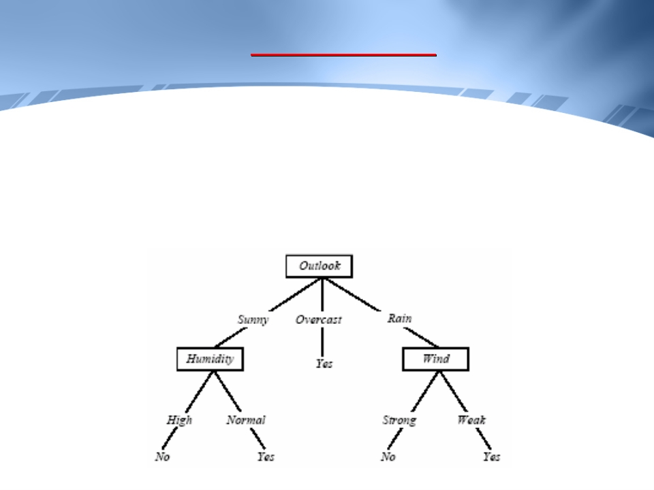
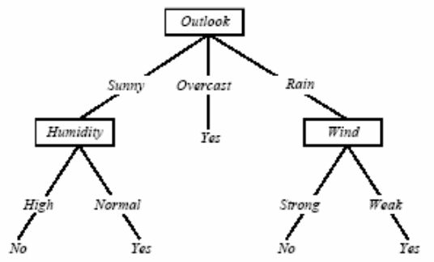
DECISION TREES
Avoiding Over-fitting the Data
Example:
Sunny, Hot, Normal Humidity, Strong Wind = No Tennis
18

Slide 20
DECISION TREES
Avoiding Over-fitting the Data
Over-fitting can also occur when small number of training
examples are associated with leaf nodes
In this case, it is possible for coincidental regularities to
occur, in which some attribute happens to partition the
examples very well, despite being unrelated to the actual
target function. Whenever such coincidental regularities
exist, there is a risk of over-fitting. There is no remedy for
such over-fitting. We can only detect it by validation set
Example: If Days is an attribute, and we have only one or
two observations for each day
19

Slide 21
DECISION TREES
Avoiding Over-fitting the Data
There are several approaches to avoid over-fitting.
One popular approach is to prune over-fit trees
A key question is: what criterion is to be used to determine
the correct final tree size
A commonly used practice is to use a separate set of
examples, distinct from training examples, (called validation
set) for post-pruning nodes
20

Slide 22
DECISION TREES
Avoiding Over-fitting the Data
In this approach, the available observations are separated
into sets:
- A training set: which is used to learn the decision
tree
- A validation set: which is used to prune the tree
The motivation: Even though the learner may be misled by
random errors and coincidental regularities within
the training set, the validation set is unlikely to exhibit
the same random fluctuations
21

Slide 23
DECISION TREES
Avoiding Over-fitting the Data
Therefore, the validation set can be expected to provide a
safety check against over-fitting the spurious
characteristics of the training set
Of course, it is important that the validation set be large
enough to itself provide a statistically significant
sample of the instances
One common heuristic is to withhold one-third of the
available examples for the validation set, using the
other two-thirds for training
22

Slide 24
DECISION TREES
Avoiding Over-fitting the Data: Reduced Error Pruning
One approach is called “reduced error pruning”
It is a form of backtracking in the hill climbing search
of decision tree hypotheses space
It considers each of the decision nodes in the tree to be
candidates for pruning
Pruning a decision node consists of
- removing the sub-tree rooted at that node, making it
a leaf node, and
- assigning it the most common classification of the
training examples affiliated with that node
23

Slide 25
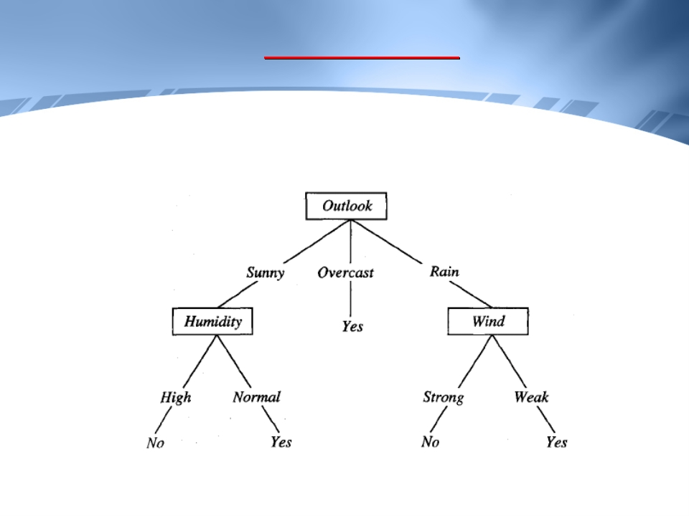
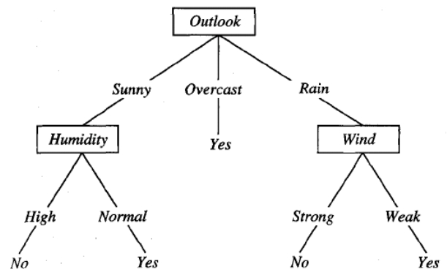
DECISION TREES
Example
24

Slide 26
DECISION TREES
Avoiding Over-fitting the Data: Reduced Error Pruning
Nodes are removed only if the resulting pruned tree
performs no worse than the original over the
validation set
This has the effect that any leaf node added due to
coincidental regularities in the training set is likely to
be pruned because these same coincidences are
unlikely to occur in the validation set
Nodes are pruned iteratively, always choosing the node
whose removal most increases the decision tree
accuracy over the validation set
25

Slide 27
DECISION TREES
Avoiding Over-fitting the Data: Reduced Error Pruning
Pruning of the node continues until further pruning is
harmful (i.e. decreases accuracy of the tree over the
validation set)
Here, the available data has been split into three sub-sets:
- the training examples
- the validation examples for pruning
- the test examples used to provide an unbiased estimate
of accuracy of the pruned tree
26

Slide 28
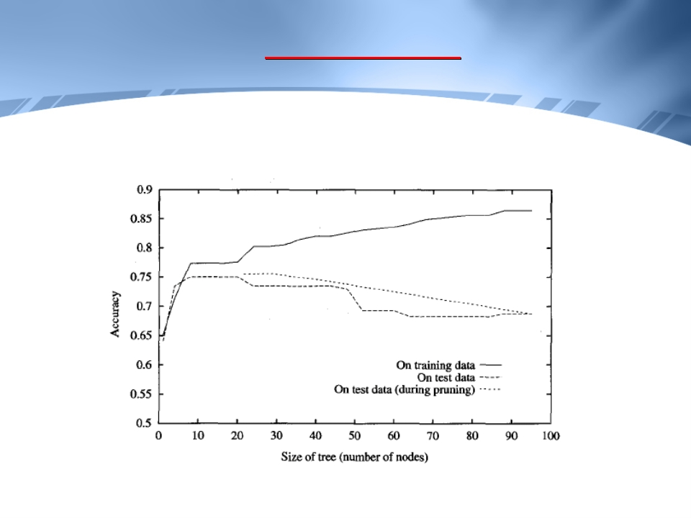
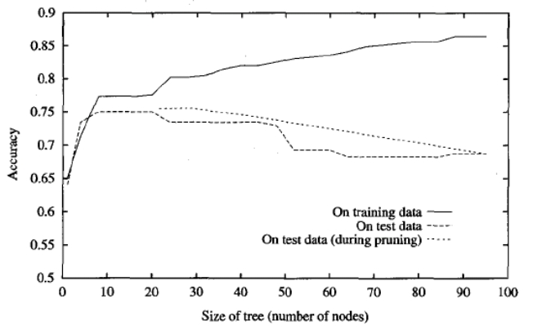
DECISION TREES
Avoiding Over-fitting the Data: Reduced Error Pruning
27

Slide 29
DECISION TREES
Avoiding Over-fitting the Data: Reduced Error Pruning
The major drawback of this approach is that when data is
limited, withholding part of it for the validation set
reduces even further the number of examples
available for training
28

Slide 30
DECISION TREES
Reference
Sections 3.5, 3.6, 3.7.1
of T. Mitchell
29

